Slide 1
Activity-Centered Design
Written by: Donald A. Norman
Presented by: Stan Gasque

Slide 2
Contents
Donald A. Norman
taxonomy vs. taskonomy
activity-centered design
software that supports users’ needs

Slide 3
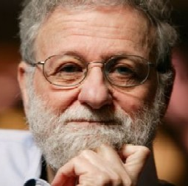
Donald A. Norman
cognitive science at University of California
computer science at Northwestern Univ.

Slide 4
Taxonomy
“hardware store” organization
well-suited for structured retrieval
ill-suited for activities

Slide 5
Taskonomy
activity-centered organization
e.g. blacksmiths and carpenters

Slide 6
Activity-Centered Design
engineer - human behavior illogical and irrational
user - human behavior perfectly sensible
activity-centered design supports human behavior

Slide 7
Supporting Users’ Needs
need both organizational structures
  heirarchical before action
  usage during action

Slide 8
In Practice
cell phone menus
iDrive
websites
PC

Slide 9
Bringing it all Together
activity-centered design
traditional human-centered design
develop with both

Slide 10
Activity-Centered Design
Written by: Donald A. Norman
Presented by: Stan Gasque

